Slide 1
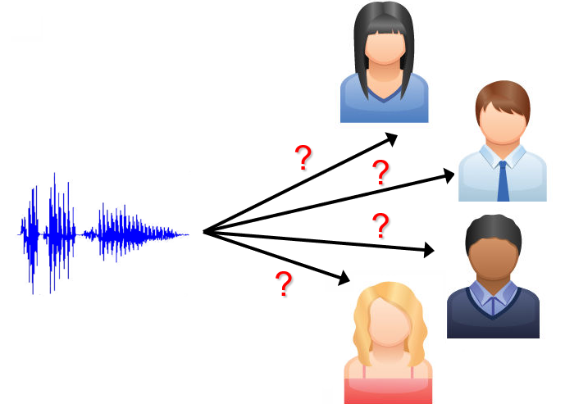
Speaker Verification using Machine and Deep Learning Approaches
on the VoxCeleb Dataset
Yixiong Chen, Zuojun Zhou, Susan Wang, Yuhao Zheng
Dec. 6th, 2024
Notes:
Visual: Diagram of a speaker verification pipeline.

Slide 2
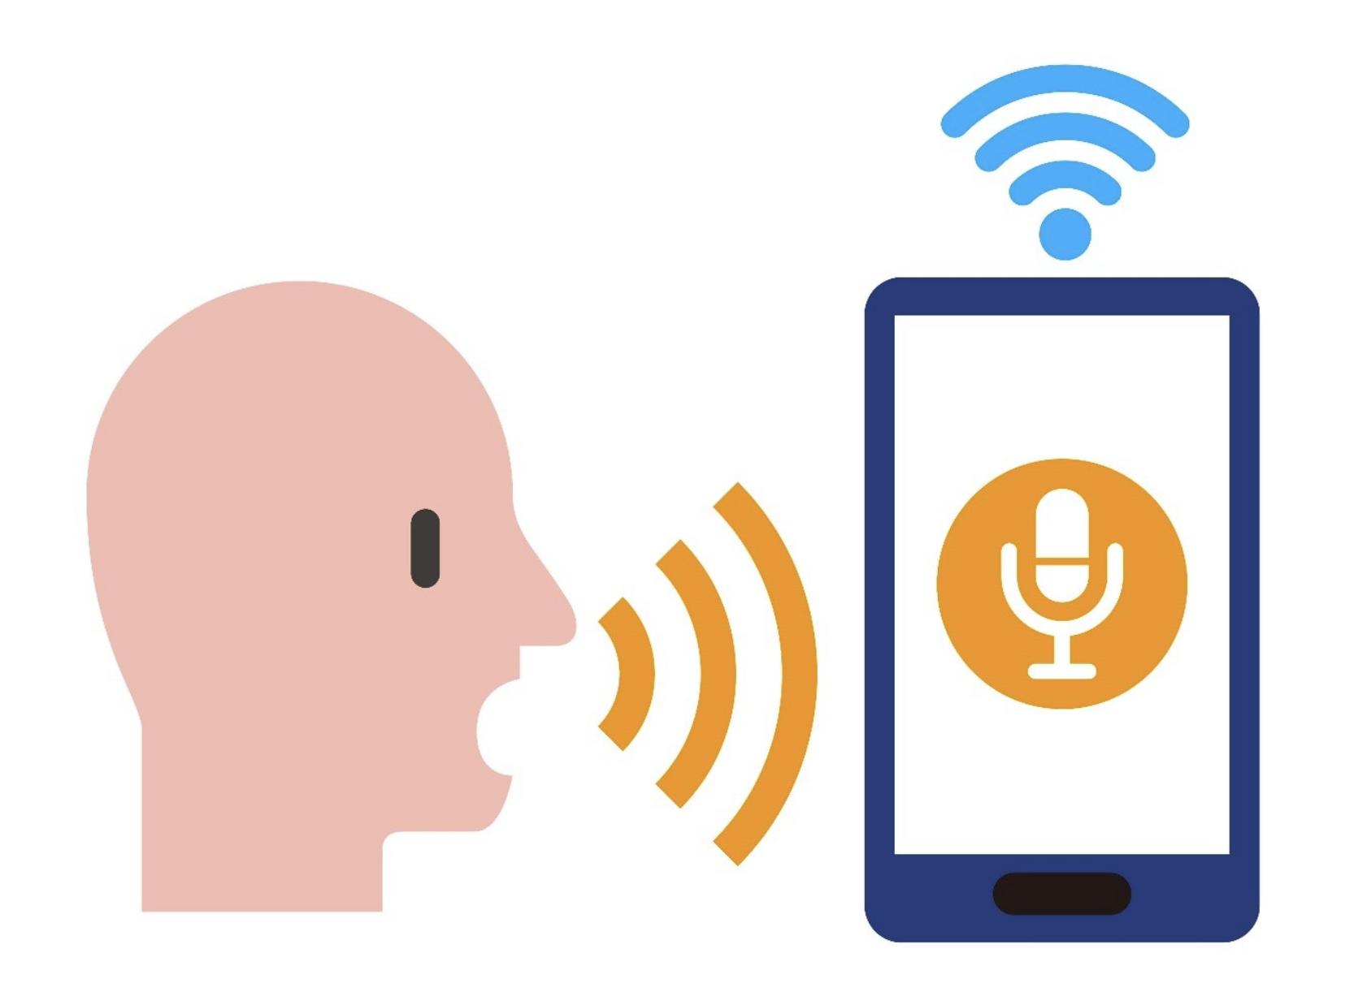
Introduction
Speak Verification:
recognize who is speaking from a clip of audio recordings accurately.
Importance:
Device unlocking, Touchless control, create personalization, etc.
huge real-world usage with a focus on security and usability.

Slide 3
Project Goal
Build >1 models that can accurately recognize who is speaking from audio recordings
compare the performance of Machine Learning and Deep Learning approaches

Slide 4
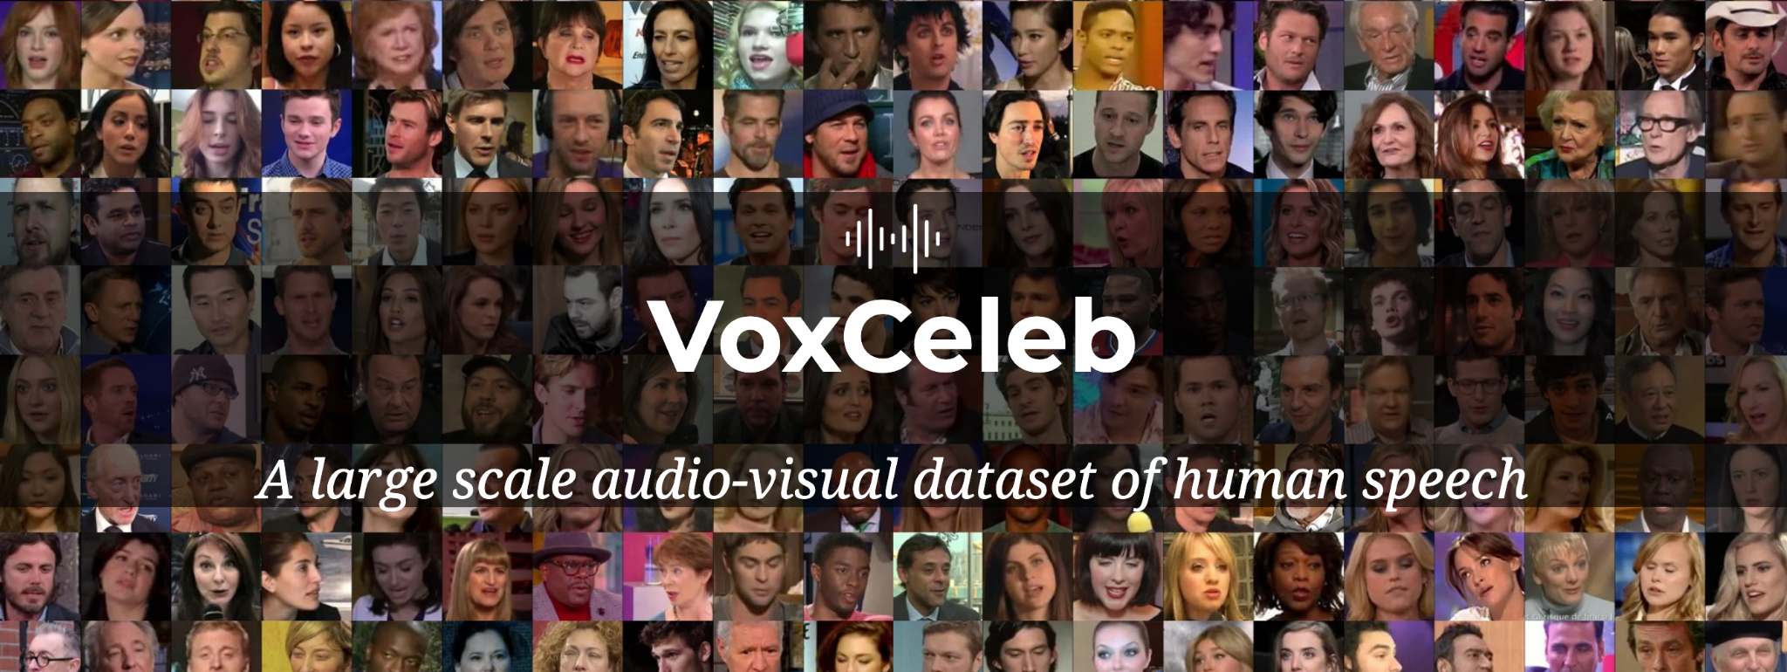
Dataset Overview: VoxCeleb

Slide 5
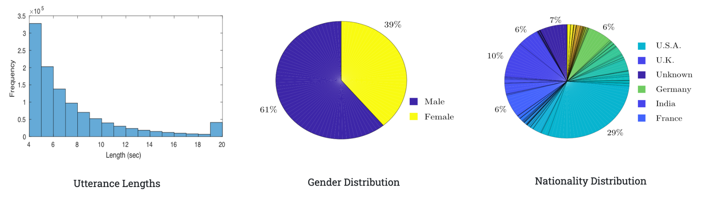
Dataset Overview
Key Features:
Diversity and scale
Real-world noises and variability
Rich features: opportunity for preprocessing
Notes:
7000+ speakers from different countries and ethnicities
1 million+ utterance

Slide 6
Data Preprocessing
Normalization
resample to 16 kHz
maintain uniform time resolution
trimmed to remove silence and background noise
focus on speech segments
Notes:
To prepare the dataset for modeling

Slide 7
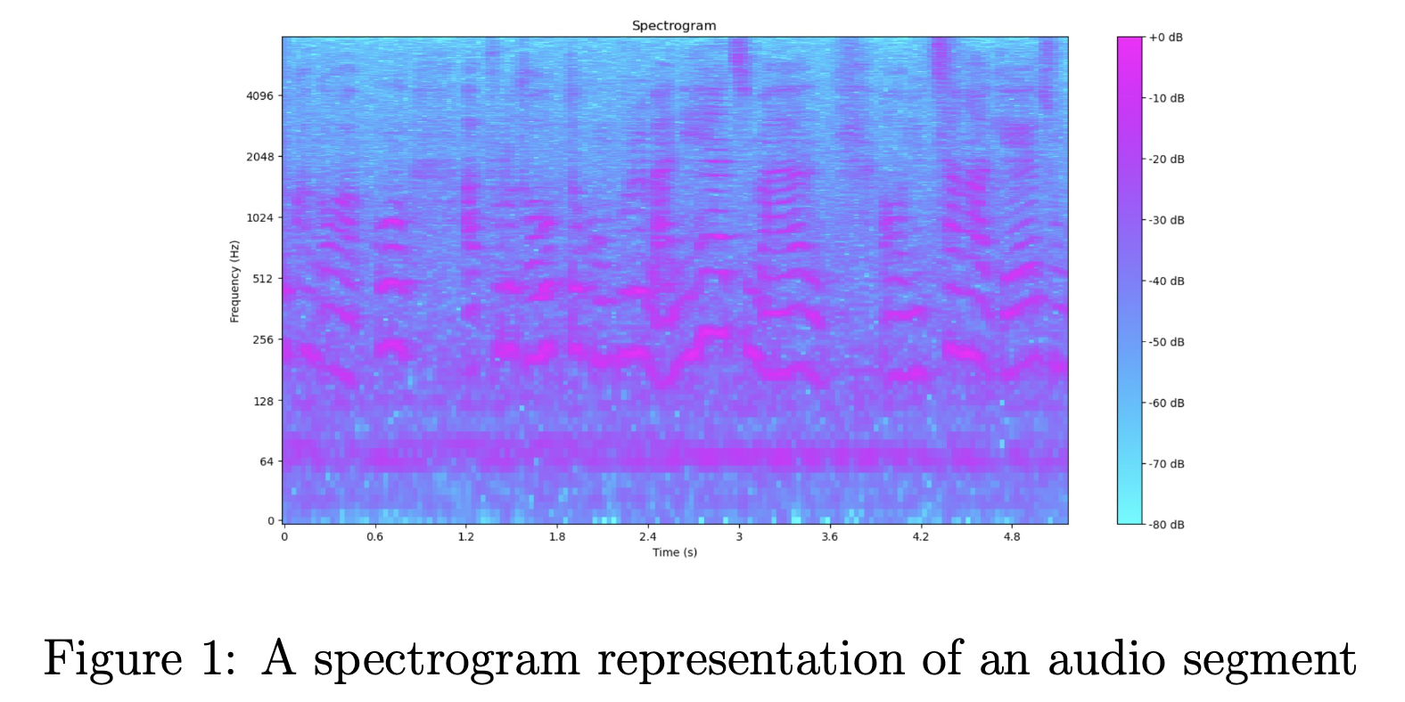
Feature Extraction
For traditional ML models:
Pitch: Mean and standard deviation of fundamental frequency (f0)
Mel-Frequency Cepstral Coefficients (MFCCs): 13 Mel-Frequency Cepstral coefficients and their deltas.
Spectral Features: Centroid, contrast, and chroma.
Energy, Zero-Crossing Rate (ZCR): Capture signal dynamics.
Notes:
For segments considered valid, we extracted a range of traditional audio features Figure 1 illustrates why spectral features are valuable: Highlighting feature extraction from frequency bands.

Slide 8
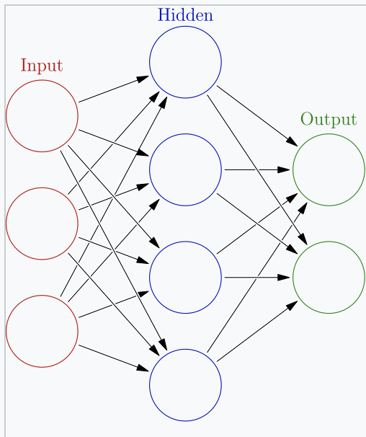
Feature Extraction
For DL models:
Direct use of raw audio or log-Mel spectrograms.
hand-crafted features (YAMNet)

Slide 9
Methodology: ML Models
1. Naive Bayes
2. Logistic Regression
3. Support Vector Machines (SVM):
Kernels: Linear, RBF.
Tuned Parameters using grid search: C (regularization), γ (kernel coefficient).
4. Random Forest: Decision trees optimized for depth and estimators.
5. XGBoost: Advanced tree-based model
Notes:
Tradition ML models, such as …, were trained on the extracted features.

Slide 10
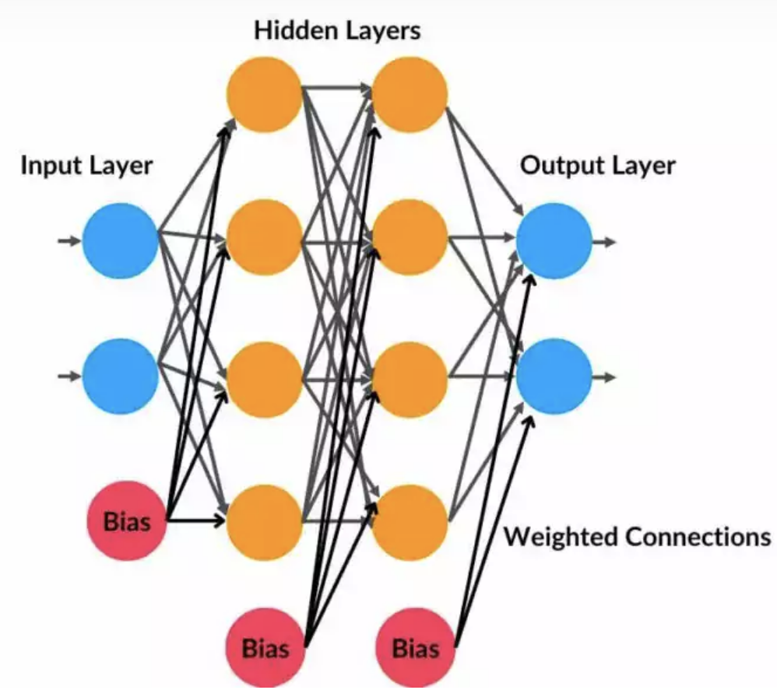
Methodology: DL Models
Three Multilayer Perceptron (MLP) Architectures:
SmallNet (2 layers), MediumNet (3 layers), LargeNet (4 layers).
trained from scratch using extracted embeddings.

Slide 11
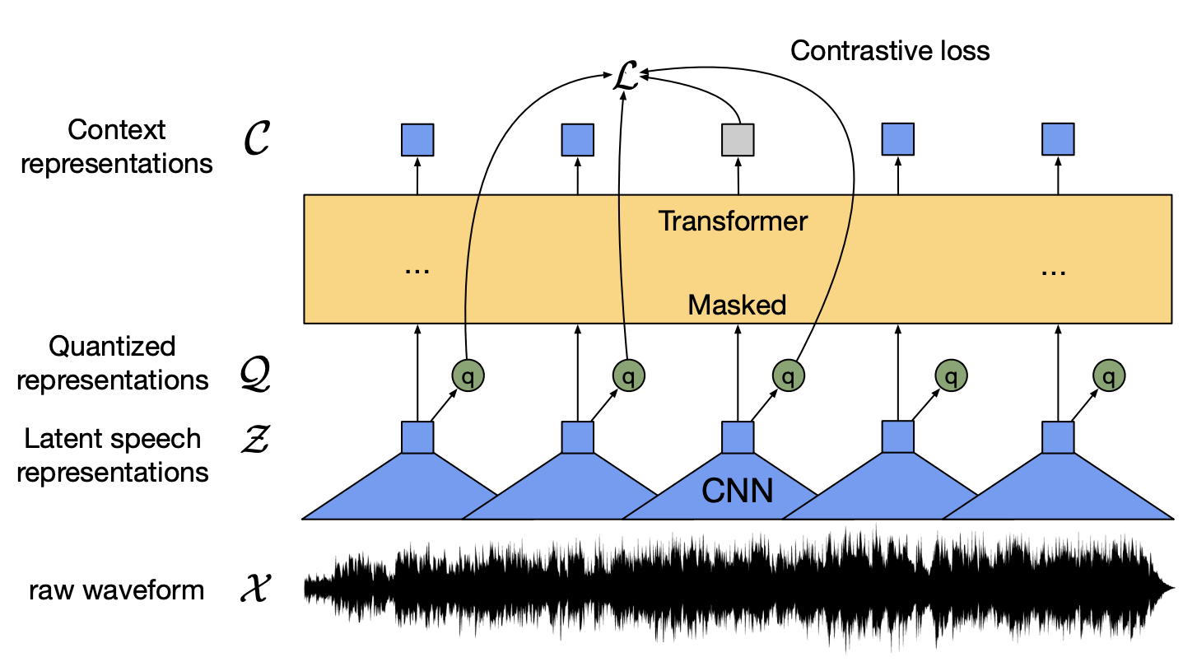
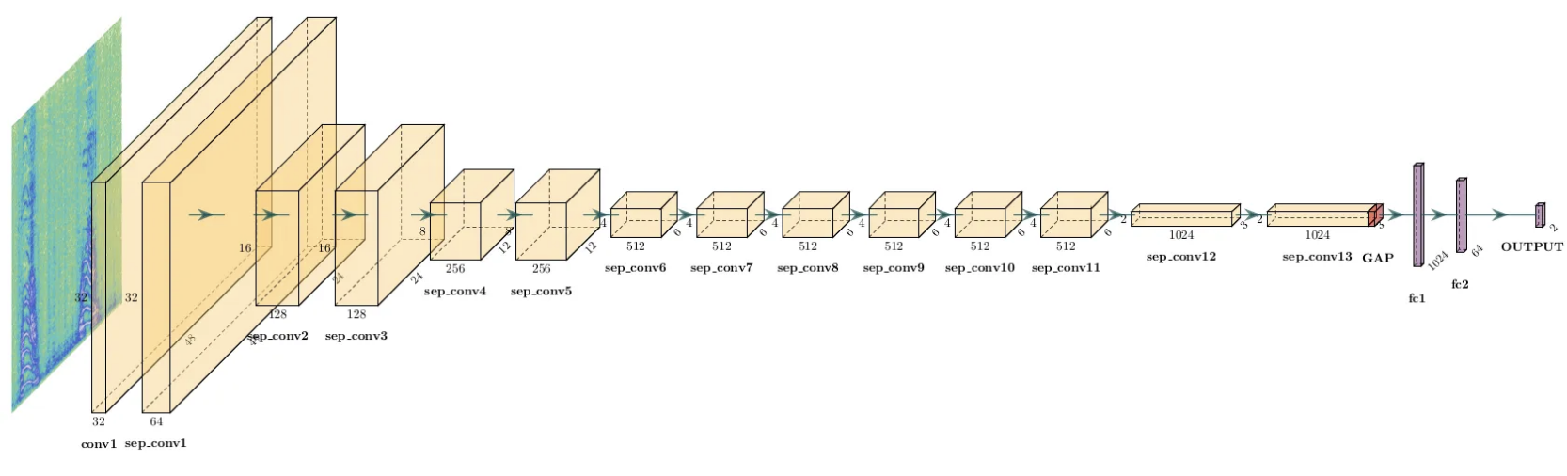
Methodology: DL Models
Pre-trained Models (on 200-speaker subset):
Wav2Vec: Fine-tuned for speaker classification.
YAMNet: Adapted from sound event detection to speaker tasks.
Notes:
Left: Wav2Vec: Wav2Vec is a neural network model developed by Facebook AI.
It learns features directly from raw audio waveforms, enabling tasks like speech recognition with minimal labeled data.
Right: YAMNet: YAMNet is a lightweight deep learning model by Google for audio classification, trained on the AudioSet dataset.
It identifies sound events and classifies them into predefined categories based on their acoustic characteristics.

Slide 12
Evaluation Metrics
Accuracy:
% of correctly classified samples.
Primary metric for comparison.
Training Time:
Qualitative
We balances clarity in comparisons and real-world feasibility.

Slide 13
Experiment Setup
Dataset: VoxCeleb (200-speaker subset used for consistency).
Data split: 80% training, 20% testing (no speaker overlap).
Inputs:
ML: Hand-crafted features (e.g., MFCCs, ZCR).
DL: Raw audio or spectrograms, plus hand-crafted features (YAMNet)
Baseline vs. fine-tuned models tested.

Slide 14
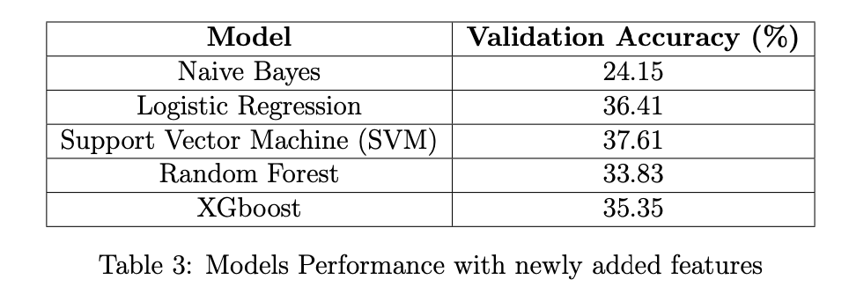
Machine Learning Results

Slide 15
Machine Learning Results
Hyperparameter Optimization
After extensive tuning,
optimized XGBoost achieved 35.35% accuracy
Key tuned parameters:
Learning rate: 0.05
Max depth: 10
Estimators: 1000
Subsample: 0.4

Slide 16
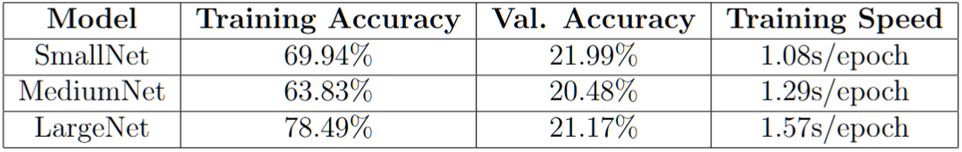
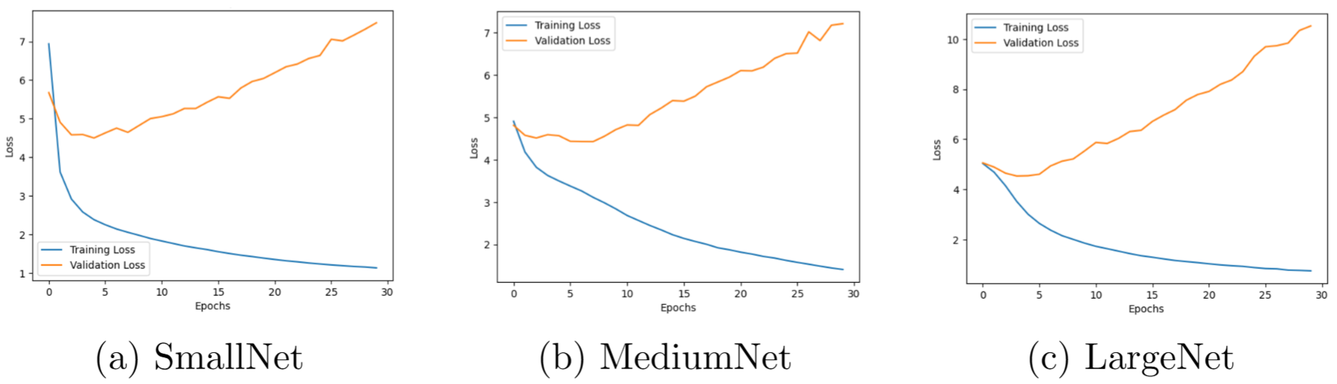
Deep Learning Results
MLP Models

Slide 17
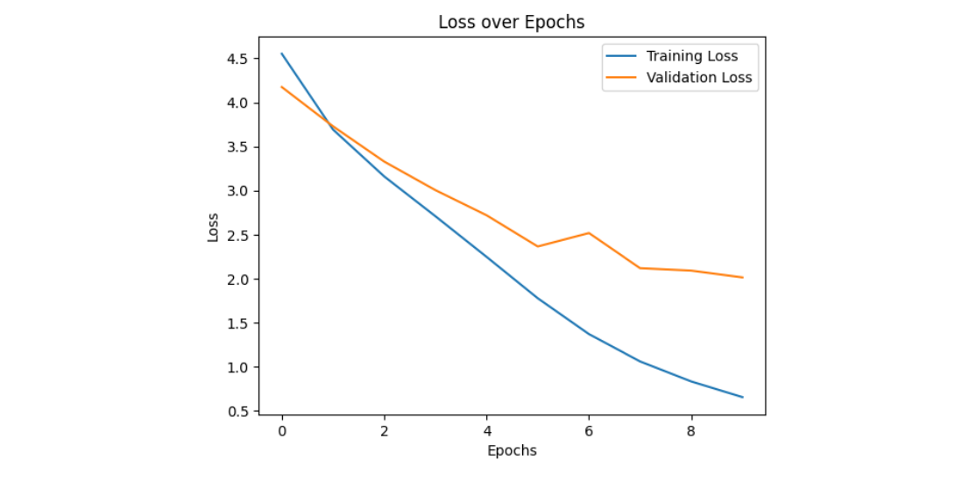
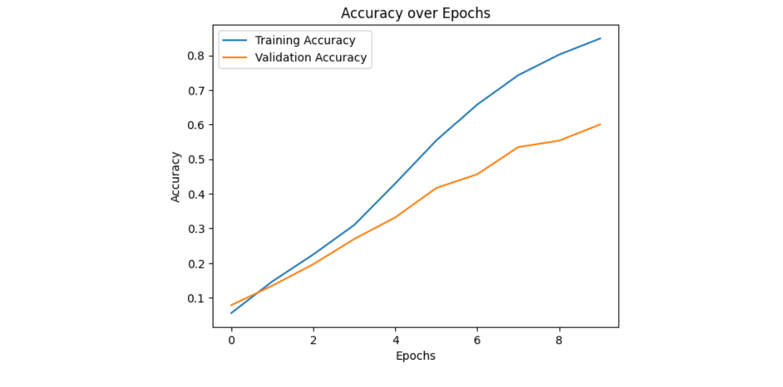
Deep Learning Results
Fine-Tuned Models
HuBERT: Not fine-tuned; high computational cost.
One iteration is ≈ 17 seconds for a batch of two audio clips, equivalent to 203 hours for an epoch.
Wav2Vec:
Training: 84.92%; Validation: 60.03%. (Took about 7 hours (3.8 iterations per second) to train the model for 10 epochs)

Slide 18
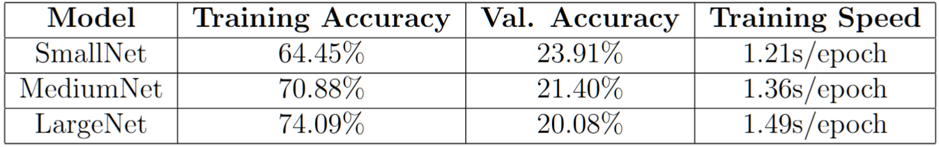
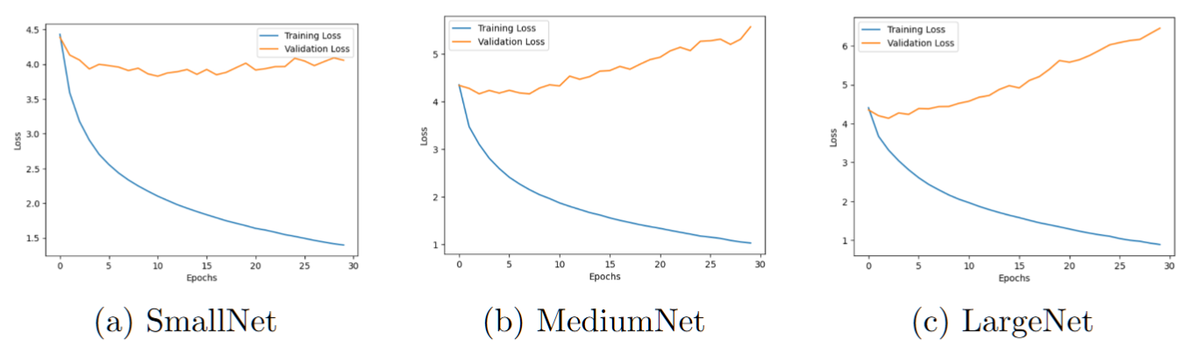
Deep Learning Results
YAMNet:

Slide 19
Overall Performance Comparison
Deep Learning Outperforms Traditional Machine Learning
Wav2Vec Model: Validation Accuracy: 60.03%
Best ML Model (SVM): Validation Accuracy: 37.61%
Performance Gap:
DL models effectively capture complex speaker-specific features.
Traditional ML relies on on manually designed features (MFCCs, ZCR)
Notes:
Visual: A trade-off graph between accuracy and computational cost.

Slide 20
Computational Considerations
Traditional ML Models:
Hardware: Trained on Apple M2 Pro CPU
Pros: Quick training iterations, low resource requirements
Suitability: Ideal for environments with limited computational power
Deep Learning Models:
Hardware: Trained on AMD Ryzen 5900X CPU & NVIDIA RTX 3060 GPU
Cons: Higher computational demands, longer training times
Trade-Off: Achieves higher accuracy but requires more computational resources
Notes:
Visual: A trade-off graph between accuracy and computational cost.

Slide 21
Conclusion, Future Work
DL models (Wav2Vec) outperform ML in speaker verification.
ML still works for lightweight applications.
Future Directions:
Making deep learning methods more resource-efficient.
Optimize training pipelines to reduce computational overhead without losing performance. (Pre-process and cache audio features)
Notes:
Visual: A roadmap or flowchart for future directions.

Slide 22
Thank You!
Any Questions?

Slide 23
References
[1] McFee, B., et al. ”librosa: Audio and music signal analysis in python.” Proceedings of the 14th Python in Science Conference. 2015.
[2] Chen, T., and Guestrin, C. ”XGBoost: A scalable tree boosting system.” Proceedings of the 22nd ACM SIGKDD International Conference on Knowledge Discovery and Data Mining. 2016.
[3] Schneider, S., Baevski, A., Collobert, R., Auli, M. (2019). ”Wav2vec: Unsupervised pre-training for speech recognition.” In Advances in Neural Information Processing Systems (pp. 8012-8022).
[4] Hsu, W.-N., Heigold, G., Bollegala, D., Chen, J., Eisenschlos, J., Raffel, C., Auli, M. (2021). ”HuBERT: Self-Supervised Speech Representation Learning by Masked Prediction of Hidden Units.” arXiv preprint
arXiv:2106.07447.
[5] Campbell, N., Klatt, D., Bergstra, J., Bergstra, S. (2020). ”YAM-Net: A Pretrained Audio Event Classification Model and Dataset.” arXivpreprint arXiv:2009.03029.
[6] Praat Developers. ”pyin: Pitch tracking.” https://librosa.org/doc/main/generated/librosa.pyin.html
[7] Loshchilov, I., Hutter, F. (2017). ”Decoupled Weight Decay Regularization.” arXiv preprint arXiv:1711.05101.
[8] TensorFlow Hub Team. ”TensorFlow Hub.” https://www.tensorflow.org/hub.

